Slide 1
Capstone Project
ALY6140 Analytics Systems Technology
Analyzing Crime Patterns in Boston
Team 2
Sreedevi Ravi Rushikesh Sawant

Slide 2
Introduction
The objective of this project is to identify patterns and insights that can enhance Boston's law enforcement and crime prevention efforts
Latest version of Crime Incident Reports dataset for 2023 available on the Boston Government will be analyzed
To reveal concealed trends in the data, we will utilize visualization techniques like bar plots, geographic maps, and line graphs
Machine learning models – logistic regression and decision tree will be employed to predict or find probability of shooting
Dataset
The data is provided in Comma Separated Values (CSV) format
Comprises 11207 rows and 17 columns

Slide 3
Business Questions
1) What are the most common types of crimes reported in Boston, and how have they changed over time?
2) Are certain areas of the city more prone to crime than others, and what factors contribute to this?
3) How does the frequency of crime incidents vary by time of day, day of the week, and month of the year?
4) Can the likelihood of a location or district having a crime due to a shooting be predicted?

Slide 4
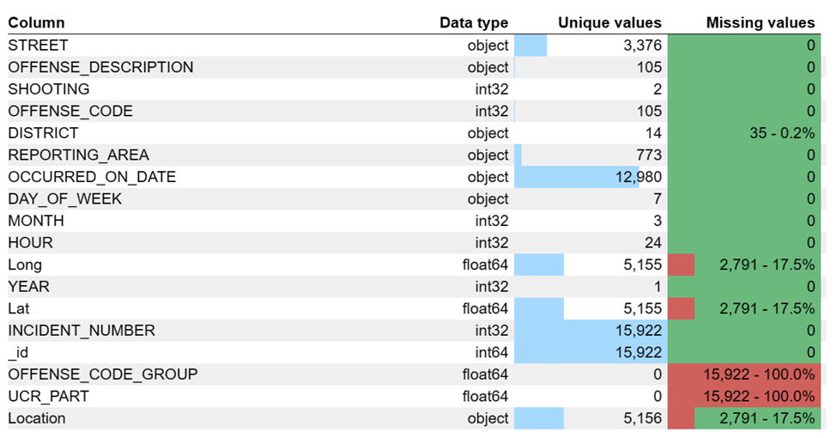
Data preparation
OFFENSE CODE GROUP and UCR PART columns removed from further analysis due to missing values
Missing values in DISTRICT, Lat, Long, and Location columns were imputed
DISTRICT missing values imputed using the mode (most frequent value)
Mean latitude and longitude calculated for each district after filling in missing DISTRICT values
Missing latitude and longitude values within each district filled in with their respective mean values
Latitude and longitude values converted to string format to fill in missing Location values
Glimpse of the dataset

Slide 5
Exploratory Data Analysis

Slide 6
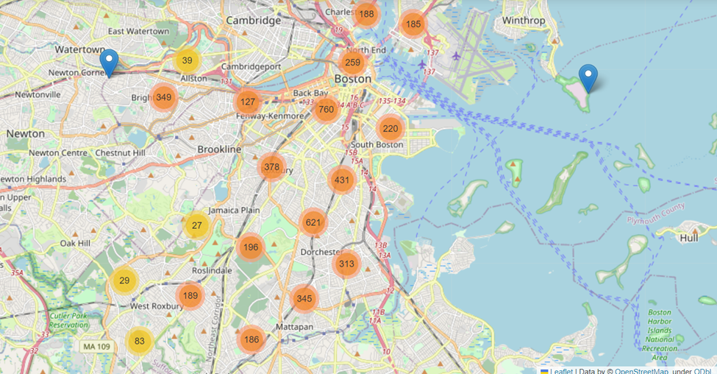
Map of Boston with crime incident clusters
By using a clustering algorithm to group crime incidents into geographic clusters, a map was generated which provides a way to identify areas with high crime rates and potential crime hotspots

Slide 7
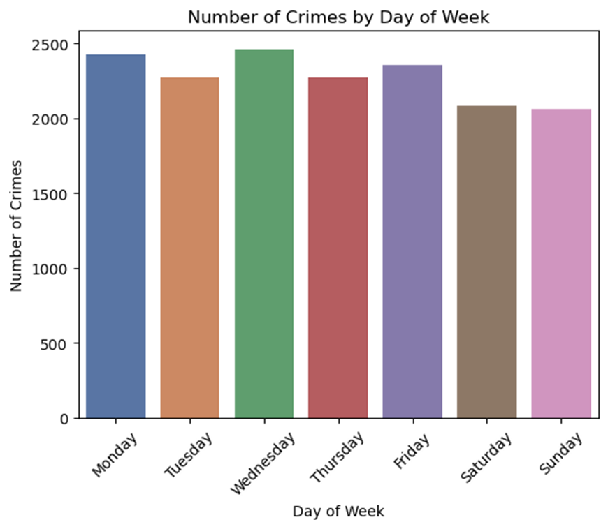
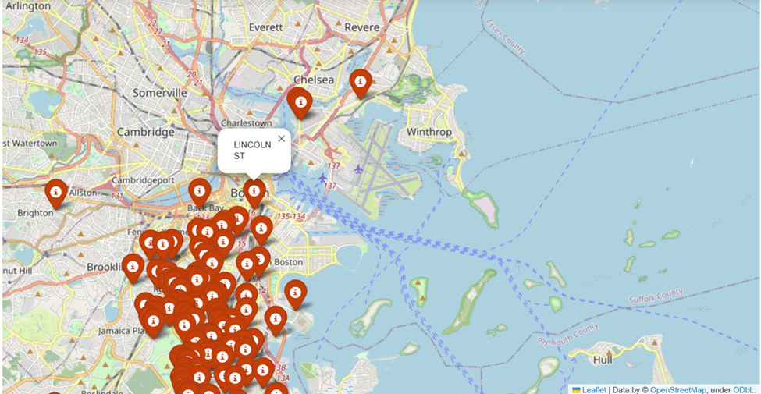
EDA
Areas of shooting
Number of Crimes by Day
The shooting locations were plotted on a map, which shows the street when we hover over the point
The plot shows that crime incidents in Boston are most frequent on Monday and Wednesday, and relatively lower on Saturday and Sunday

Slide 8
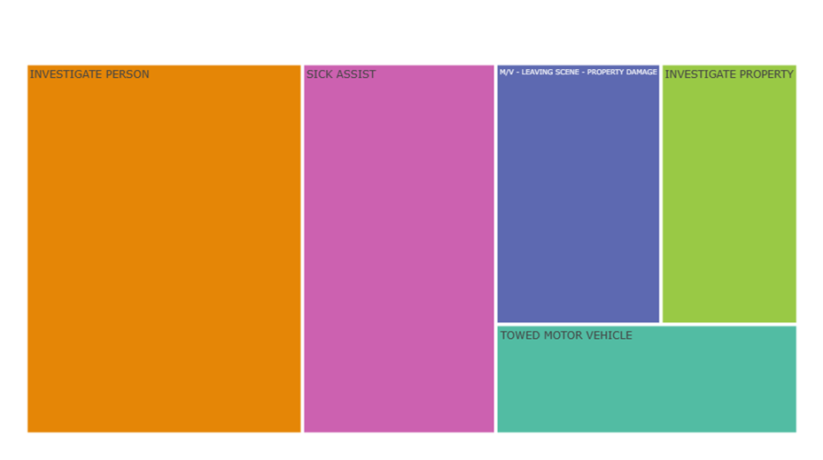
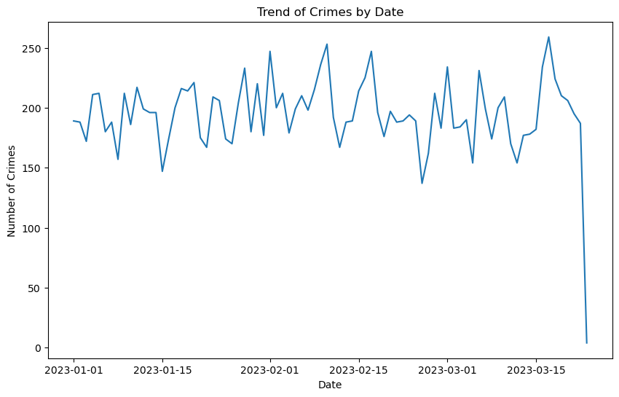
EDA
Trends of crimes
Treemap for offense
The crime rate saw a dip in mid of February but peaked again in March.
The most common offense is in investigating a person who committed a crime

Slide 9
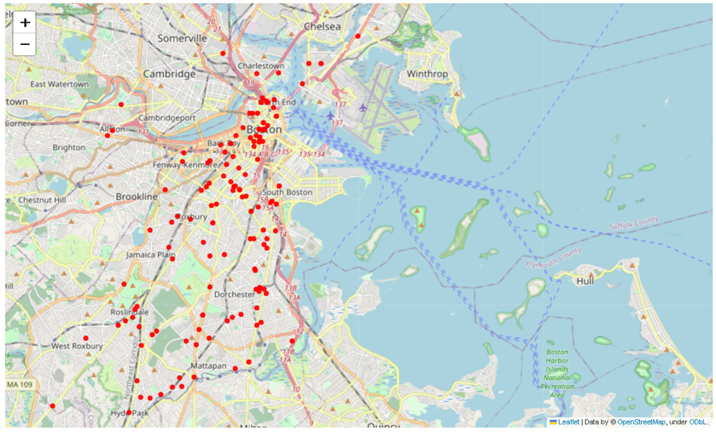
Robberies in Boston City
The scatter map plot shows a concentration of red circles, which represent the locations of robberies, in Boston city
By analyzing the scatter map plot, it can be inferred that downtown Boston has a higher rate of robberies than other areas in the city, based on the number of red circles plotted in that area compared to other parts of the map

Slide 10
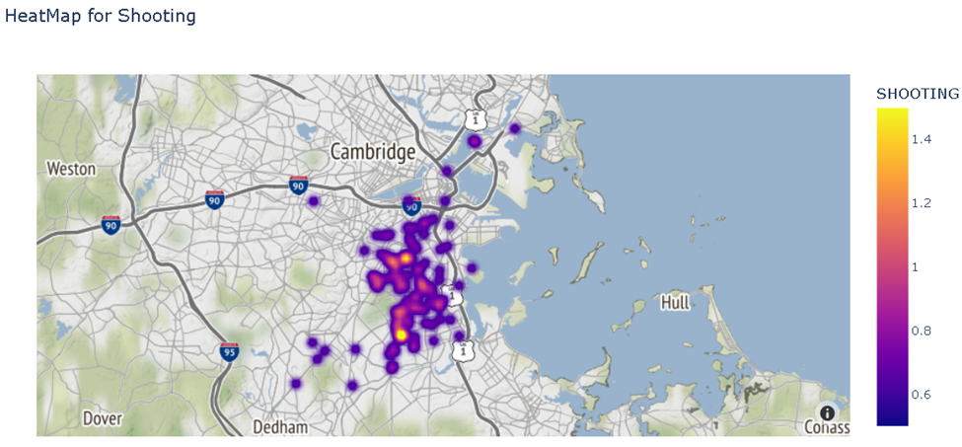
Heatmap for shooting in Boston City
The heatmap of shootings in Boston provides a clear visualization of the distribution of shootings across the city, with hotspots appearing in certain neighborhoods. The heatmap can help identify high-risk areas and inform targeted interventions to prevent and reduce gun violence.

Slide 11
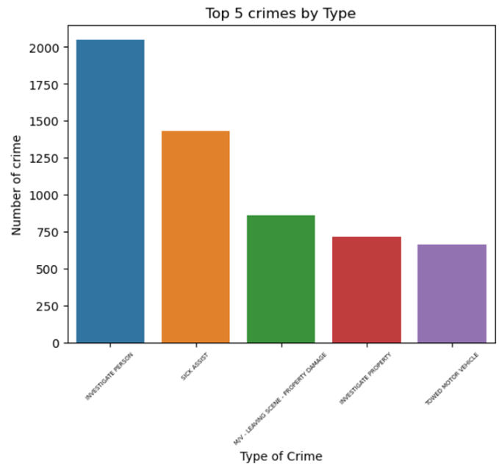
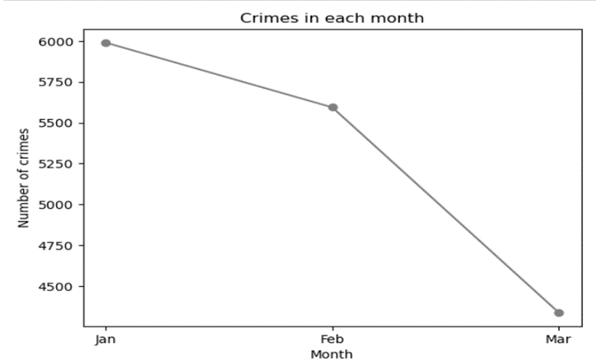
EDA

Slide 12
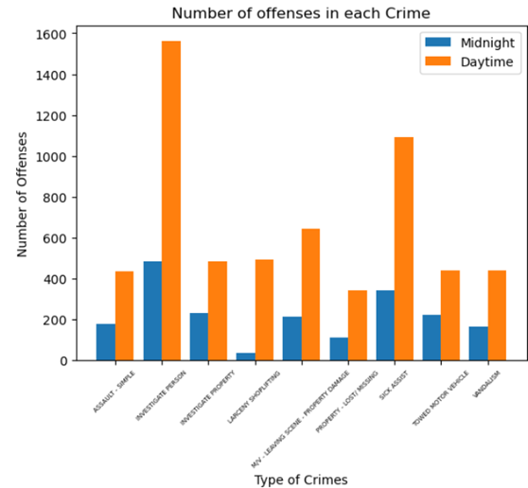
EDA
A bar plot comparing crime rates during daytime and nighttime in Boston reveals that overall, crime rates are significantly higher during the day
Crimes related to investigations of persons and sick assistance also exhibit higher rates during daytime

Slide 13
Predictive Models

Slide 14
Logistic Regression model:
Predicts if a shooting will occur or not based on relevant attributes using logistic regression.
Logistic regression is a statistical model used for binary outcomes.
Decision Tree:
Categorical variables encoded using LabelEncoder() from sklearn.preprocessing.
DISTRICT, DAY_OF_WEEK, and STREET chosen as independent variables.
Target variable is SHOOTING.
Model predicts probability of a shooting occurrence.
Predictive Models

Slide 15
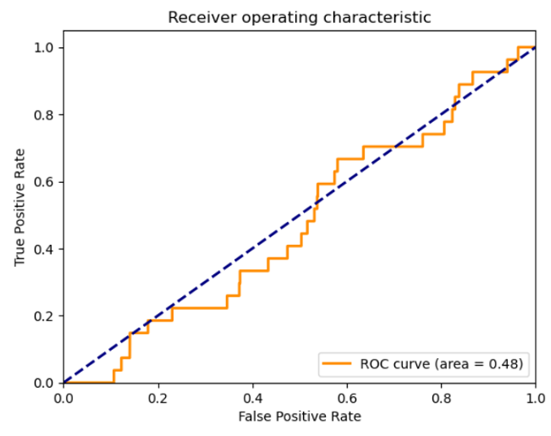
Logistic Regression for Predicting Shooting
Accuracy of 99.15%
This suggests that the model is capturing mildly strong relationship between the predictor variables and the target variable, but there may be room for improvement through fine-tuning or incorporating additional data.

Slide 16
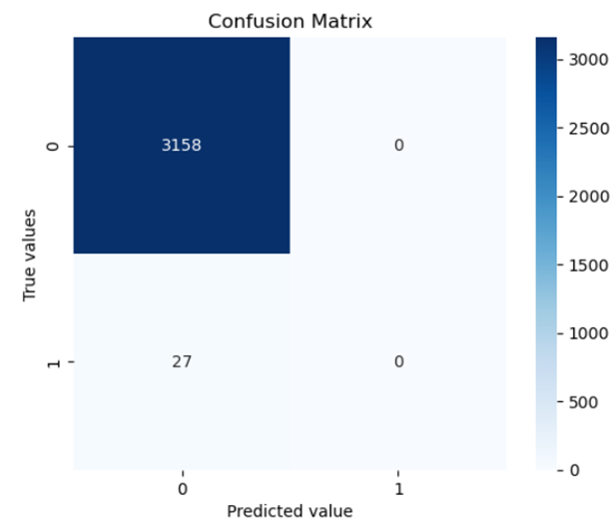
Logistic Regression for Predicting Shooting
The confusion matrix showed that the model correctly predicted 3158 instances of the negative class (no shooting) and 0 instances of the positive class (shooting) (true positives)
Moreover, the model predicted zero instances of the negative class as positive (false positive) and 27 instances of the positive class as negative (false negative) (false negatives)

Slide 17
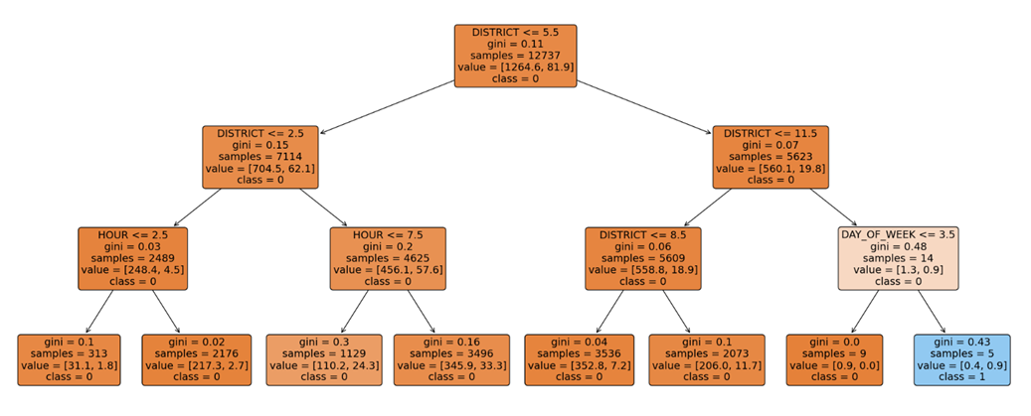
Decision Tree for Predicting Shooting

Slide 18
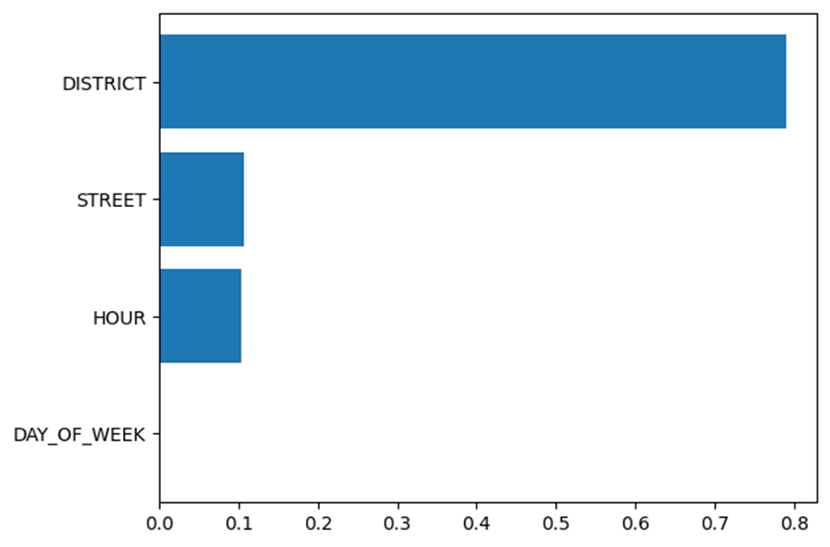
Decision Tree for Predicting Shooting
Confusion Matrix
 | Predicted Negative | Predicted Positive
Actual Negative | 3157 | 1
Actual Positive | 27 | 0
Decision tree model had an accuracy of 99.12% for predicting shooting incidents in Boston.
Class weight for each class was set inversely proportional to its frequency in the dataset.
Class weight for no shooting was set as 0.1 and for shooting occurred was set as 0.9.
Model predicted one instance of the negative class as positive (false positive) and 27 instances of the positive class as negative (false negative) (false negatives).
Model performs well in predicting the negative class but poorly in predicting the positive class due to imbalanced data.
Feature Importance

Slide 19
Recommendations &
Conclusion

Slide 20
For Boston Police:
Predictive models can identify high-risk areas for potential shootings based on historical data and relevant factors.
This information can inform targeted patrols and interventions in high-risk areas to prevent shootings before they occur.
Predictive models can forecast the likelihood of future shootings and provide early warning systems for proactive response and prevention efforts.
For People:
Predictive models can be used to identify high-risk areas for shootings in Boston.
This information can help people avoid those areas or take alternative routes to minimize their exposure to potential violence.
Application of Predictive Model

Slide 21
Conclusion
Logistic regression and decision tree models compared for predicting shootings in Boston.
Logistic regression model had an accuracy of 99.15% and decision tree model had an accuracy of 99.12%.
Logistic regression model is marginally better than the decision tree model in predicting shootings.
Logistic regression model appears to capture the relationships between predictor variables and the target variable more effectively.
Findings suggest that the logistic regression model may be a more reliable and accurate tool for predicting shootings in Boston.

Slide 22
Questions?

